Slide 1
Regularization: Noise Injection to Inputs/Outputs, Ensemble methods, Dropout
.

Slide 2
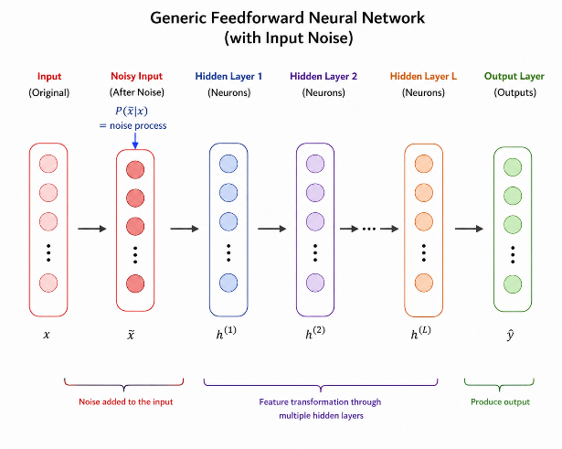
Adding Noise to the inputs
For a simple input–output neural network, injecting Gaussian noise into the inputs is equivalent, in expectation, to applying l2 weight regularization.
Input noise can also serve as data augmentation.

Slide 3






$$x_{1}+ε_{1}$$
$$x_{2}+ε_{2}$$
$$⋯$$
$${ x}_{3}+ε_{3}$$
$$⋯$$
$${ x}_{n}+ε_{n}$$

Slide 4
Hard targets
Adding Noise to the outputs
0 | 0 | 1 | 0 | 0 | 0 | 0 | 0 | 0 | 0
9
minimize : p log q
Σ
i i
i=0
true distribution : p = {0, 0, 1, 0, 0, 0, 0, 0, 0, 0}
estimated distribution : q
Do not trust the true labels, they may be noisy Instead, use soft targets

Slide 5


Soft targets
ε 9 | ε 9 | 1 — ε | ε 9 | ε 9 | ε 9 | ε 9 | ε 9 | ε 9 | ε 9
ε = small positive constant
9
minimize : p log q
Σ
i i
i=0
true distribution + noise : $p=\left\{\frac{ε}{9},\frac{ε}{9}, 1−ε,\frac{ε}{9},…\right\}$
estimated distribution : $q$

Slide 6
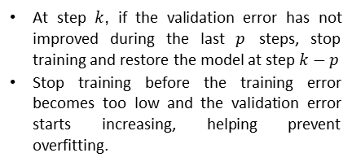
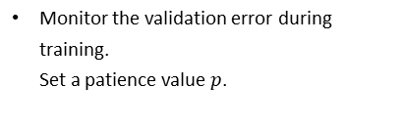
Monitor the validation error during training.
Set a patience value $p$.
Early stopping
Error
At step $k$, if the validation error has not improved during the last $p$ steps, stop training and restore the model at step $k−p$
Stop training before the training error becomes too low and the validation error starts increasing, helping prevent overfitting.
V alidation error
Training error
k − p return this model
k stop
Steps

Slide 7
Early stopping

Slide 8
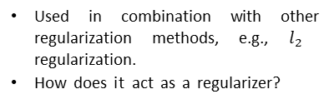
Highly effective and widely adopted regularization technique.
Error
Used in combination with other regularization methods, e.g., $l_{2}$ regularization.
How does it act as a regularizer?
V alidation error
Training error
k − p return this model
k stop
Steps

Slide 9

The update rule in SGDis
How does Early stopping act as a regularizer?
Error
w_{t+1} = w_{t} - η∇w_{t}
t
Σ
= w - η ∇w
0
i
i=1
V alidation error
Let τ be the maximum value of ∇w_{i}
Training error
|w_{t+1} — w₀| ≤ ηt|τ |
k − p return this model
k stop
Steps
Thus, t controls how far w_{t} can go from the initial w₀

Slide 13

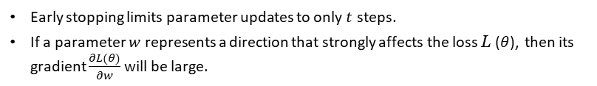
Early stopping limits parameter updates to only $t$ steps.
If a parameter $w$ represents a direction that strongly affects the loss L($θ$), then its gradient $\frac{∂L(θ)}{∂w}$will be large.
If a parameter has little influence on the loss ($\frac{∂L(θ)}{∂w}$ is small), its updates remain small, so it cannot grow much within $t$ steps.
Therefore, early stopping tends to keep less important parameters small, producing an effect similar to weight decay.

Slide 14
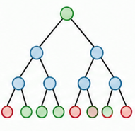
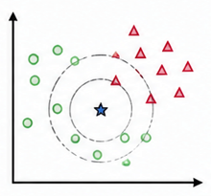

yfinal
Ensemble methods
Combine the output of different models to reduce generalization error
The models can correspond to different classifiers
It could be different instances of the same classifier trained with:
different hyperparameters
different features
different samples of the training data
ylr
ydt
yknn
Logistic
Regression
Decision Tree
KNN

Slide 15

^{y}final
^{y}lr1
^{y}lr2
^{y}lr3
Bagging: form an ensemble using different instances of the same classifier
From a given dataset, construct multiple training sets by sampling with replacement (T₁, T₂, ..., T_{k})
Train i^{th} instance of the classifier using training set T_{i}
y
y
y
Logistic Regression
Logistic Regression
Logistic Regression
Each model trained with a different sample of the data (sampling with replacement)

Slide 16
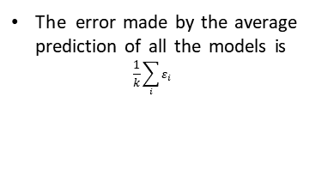
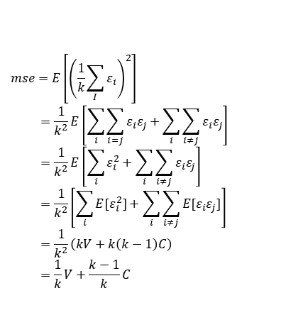
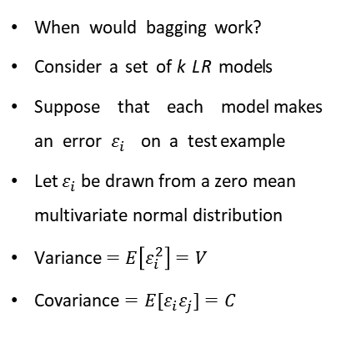
The error made by the average prediction of all the models is
$\frac{1}{k}\sum_{i}{ε_{i}}$
When would bagging work?
Consider a set of k LR models
Suppose that each model makes an error $ε_{i}$ on a test example
Let $ε_{i}$ be drawn from a zero mean multivariate normal distribution
Variance $=E\left[ε_{i}^{2}\right]=V$
Covariance $=E[ε_{i}ε_{j}]=C$
The expected squared error is :
$$mse=E\left[{\left(\frac{1}{k}\sum_{I}{ε_{i}}\right)}^{2}\right]$$
$$=\frac{1}{k^{2}}E\left[\sum_{i}{\sum_{i=j}{ε_{i}ε_{j}}}+\sum_{i}{\sum_{i≠j}{ε_{i}ε_{j}}}\right]$$
$$=\frac{1}{k^{2}}E\left[\sum_{i}{ε_{i}^{2}}+\sum_{i}{\sum_{i≠j}{ε_{i}ε_{j}}}\right]$$
$$=\frac{1}{k^{2}}\left[\sum_{i}{E[ε_{i}^{2}]}+\sum_{i}{\sum_{i≠j}{E[ε_{i}ε_{j}]}}\right]$$
$$=\frac{1}{k^{2}}\left(kV+k\left(k−1\right)C\right)$$
$$=\frac{1}{k}V+\frac{k−1}{k}C$$

Slide 17
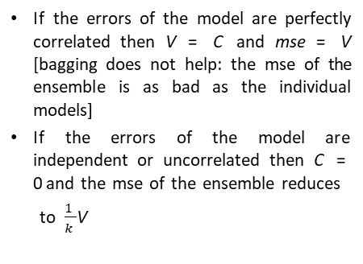
1 k — 1
mse = V +
C
When would bagging work ?
k k
If the errors of the model are perfectly correlated then V = C and mse = V [bagging does not help: the mse of the ensemble is as bad as the individual models]
If the errors of the model are independent or uncorrelated then C = 0 and the mse of the ensemble reduces
to $\frac{1}{k}$V
On average, the ensemble will perform at least as well as its individual members

Slide 18
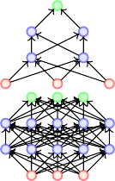
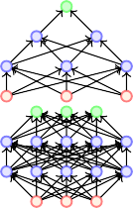
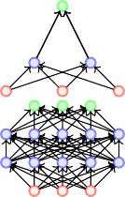
Dropout
Typically model averaging(bagging ensemble) always helps
Training several large neural networks for making an ensemble is pro-hibitively expensive
Option 1: Train several neural networks having different architec-tures(obviously expensive)
Option 2: Train multiple instances of the same network using different training samples (again expensive)
Even if we manage to train with option 1 or option 2, combining several models at test time is infeasible in real time applications

Slide 19
Dropout is a technique which addresses both these issues.
Effectively it allows training several neural networks without any signific-ant computational overhead.
Also gives an efficient approximate way of combining exponentially many different neural networks.

Slide 20
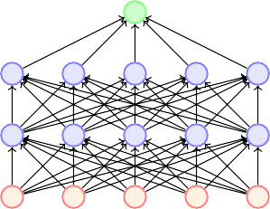



Dropout refers to dropping out units
Temporarily remove a node and all its incoming/outgoing connections resulting in a thinned network
Each node is retained with a fixed probability (typically p = 0.5) for hidden nodes and p = 0.8 for visible nodes

Slide 21
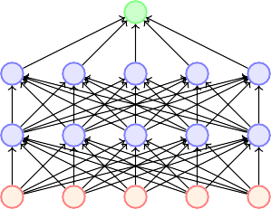
Suppose a neural network has n nodes
Using the dropout idea, each node can be retained or dropped
For example, in the above case we drop 5 nodes to get a thinned network
Given a total of n nodes, what are the total number of thinned networks that can be formed? 2^{n}
Of course, this is prohibitively large and we cannot possibly train so many networks
Trick: (i) Share the weights across all the networks
(ii) Sample a different network for each training instance

Slide 22

We initialize all the parameters (weights) of the network and start training
For the first training instance (or mini-batch), we apply dropout resulting in the thinned network
We compute the loss and backpropagate
Which parameters will we update?
Only those which are active

Slide 23
We initialize all the parameters (weights) of the network and start training
For the first training instance (or mini-batch), we apply dropout resulting in the thinned network
We compute the loss and backpropagate
Which parameters will we update? Only those which are active

Slide 24
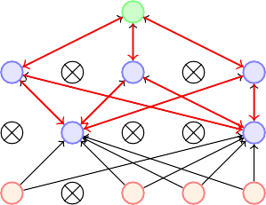
We initialize all the parameters (weights) of the network and start training
For the first training instance (or mini-batch), we apply dropout resulting in the thinned network
We compute the loss and backpropagate
Which parameters will we update? Only those which are active

Slide 25
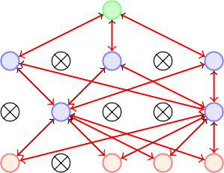
We initialize all the parameters (weights) of the network and start training
For the first training instance (or mini-batch), we apply dropout resulting in the thinned network
We compute the loss and backpropagate
Which parameters will we update? Only those which are active

Slide 26



For the second training instance (or mini-batch), we again apply dropout resulting in a different thinned network
We again compute the loss and backpropagate to the active weights

Slide 27
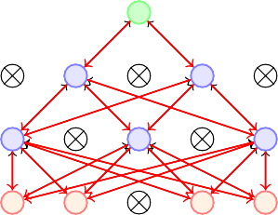
For the second training instance (or mini-batch), we again apply dropout resulting in a different thinned network
We again compute the loss and backpropagate to the active weights
If the weight was active for both the training instances then it would have received two updates by now
If the weight was active for only one of the training instances then it would have received only one updates by now
Each thinned network gets trained rarely (or even never) but the parameter sharing ensures that no model has untrained or poorly trained parameters

Slide 28
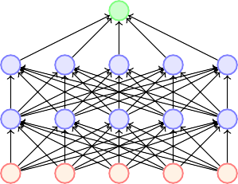
Present with probability p
Always present
w₁
pw₁
w2
pw2
w3
pw3
w₄
pw₄
At training time
At test time
What happens at test time?
Impossible to aggregate the outputs of 2^{n} thinned networks
Instead we use the full Neural Network and scale the output of each node by the fraction of times it was on during training

Slide 29

Dropout essentially applies a masking noise to the hidden units
Prevents hidden units from co-adapting
Essentially a hidden unit cannot rely too much on other units as they may get dropped out any time
Each hidden unit has to learn to be more robust to these random dropouts

Slide 30
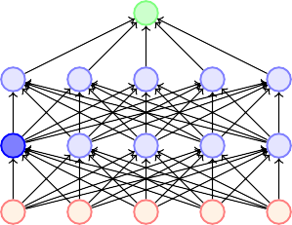
Example
Suppose h_{i} learns to detect a face by firing on detecting a nose
Dropping h_{i} then corresponds to erasing the information that a nose exists
The model should then learn another h_{i} which redundantly encodes the presence of a nose
Or the model should learn to detect the face using other features
h_{i}

Slide 31
Thank You

